Slide 1
IT306
Module 7
Tree, Priority Queue

Slide 2
Trees

Slide 3
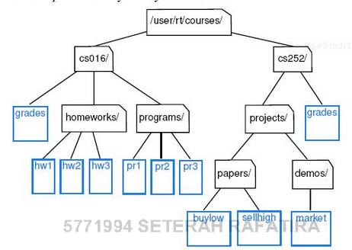
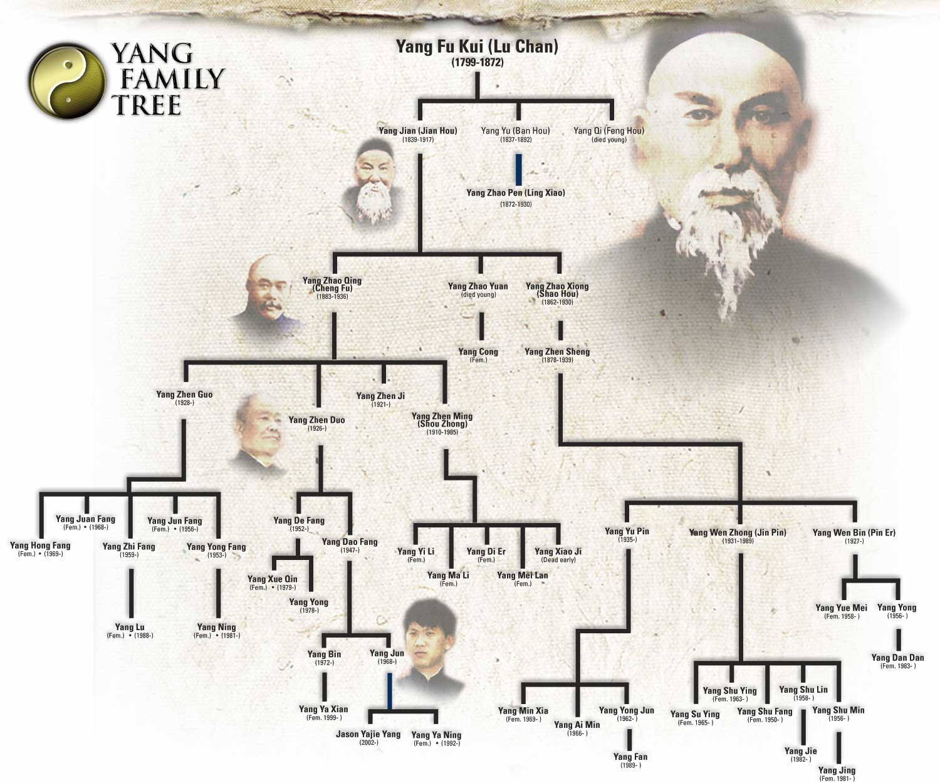
Tree: Non-linear Data Structure
Breakthrough in data organization
Faster algorithms compared to linear
Hierarchical relationships
Terminology
Root: the top node in the tree.
Parent: the converse notion of child.
Siblings: Nodes with the same parent.
Descendant: A node reachable by repeated proceeding from parent to child.
Ancestor: A node reachable by repeated proceeding from child to parent.
Leaf/External: A node with no children.
Non-leaf/Internal : A node with one or more children.
Edge: Connection between one node to another; (u,v) (u parent-of v).
Path: A sequence of nodes and edges connecting a node with descendant.
Level: The level of a node is defined by 1+ the number of connections between the node and the root.
Height: The height of a tree is the number of edges on the longest downward path between root and a leaf.
Example: File system, family tree.
http://www.yangfamilytaichi.com/yang/tree/
Notes:
Non-linear here implies organizational relationship
Richer than simple before/after relationship

Slide 4
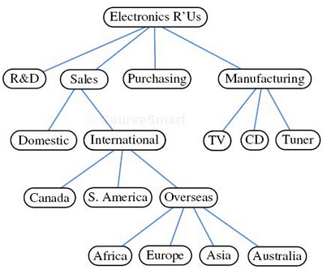
Tree
Hierarchical storage of elements with one exception: Root!
Formally: T is a set of nodes storing elements such that the nodes have parent-child relationship that satisfies the following properties:
If T is non-empty, it has a special node called root of T that has no parent.
Each node v of T different from the root, has a unique parent node w, every node with parent w is a child of w.
Empty tree: T does not have any nodes. Recursively, a tree T is either empty, or consists of a node r, called the root of T , and a (possibly empty) set of sub-trees whose roots are the children of r.
Notes:
Each element in the tree has a parent element , and 0 or more children.

Slide 5
Tree Operations
getElement(): returns the element stored at this position.
root(): returns the root of the tree.
parent(p): returns the parent of p, or null if p is the root.
children(p): returns children of p as an iterable collection.
numChildren(p): returns number of children of p.
isInternal(p): returns true if p has at least one child.
isExternal(p): returns true if p does not have any children.
isRoot(p): returns true if p is the root of the tree.
size():returns the number of elements in the tree.
isEmpty():returns true if tree does not contain any positions.
iterator(): returns an iterator for all the elements in the tree.
positions():returns an iterable collection of all elements in the tree.
Exception Handling: if the input parameter is invalid, throws IllegalArgumentException

Slide 6
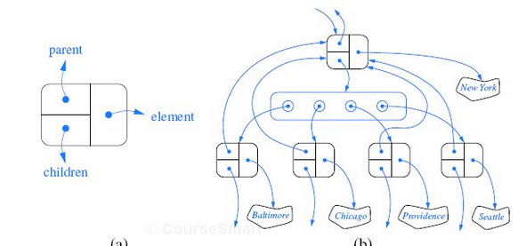
Linked Structure for General Trees

Slide 7
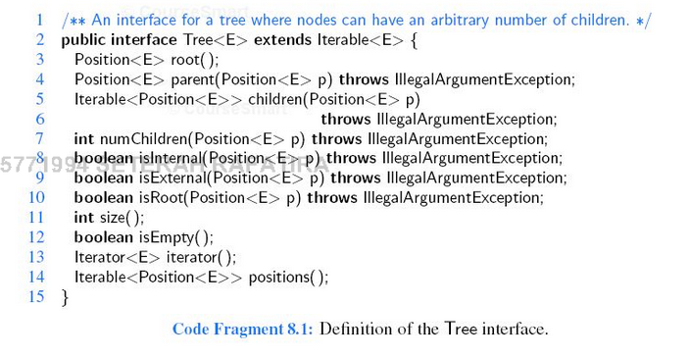
Tree Interface

Slide 8
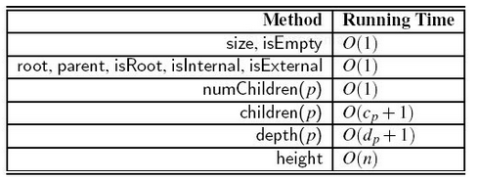
Running Times of The Accessor Methods of an N- Node General Tree

Slide 9
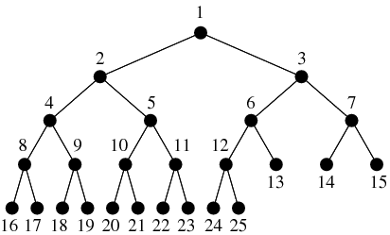
Binary Tree
Root
Siblings/ Children of node 2
Level 1
Level 2
Level 3
Level 4
Level 5

Slide 10
Binary tree
Finite set of nodes
Empty tree: no nodes including root node
Tree is a type of collection
Root: no parent
Sibling
Number of children (left, right)
Parent node
Regular node: has exactly one parent
Leaf: no children

Slide 11
Binary Tree
Find root, leaf, regular node, parent node, sibling node.
Level 1
Level 2
Level 3
Level 4
Level 5

Slide 12
More terminology
Full binary tree: if each node is either leaf or possesses exactly two children.
Complete binary tree: if all levels except possibly the last are completely full, and the last level has all its nodes to the left.

Slide 13
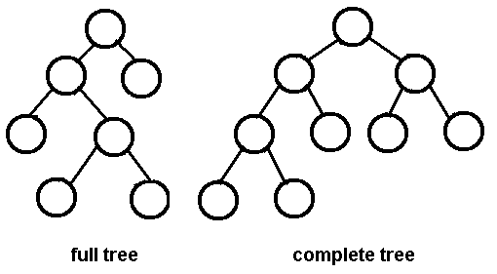
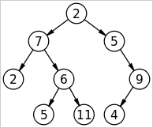
What Type of Tree?
Notes:
Full binary tree: every node, other than leaves have two children.
A complete binary tree is a binary tree in which every level, except possibly the last, is completely filled, and all nodes are as far left as possible.

Slide 14
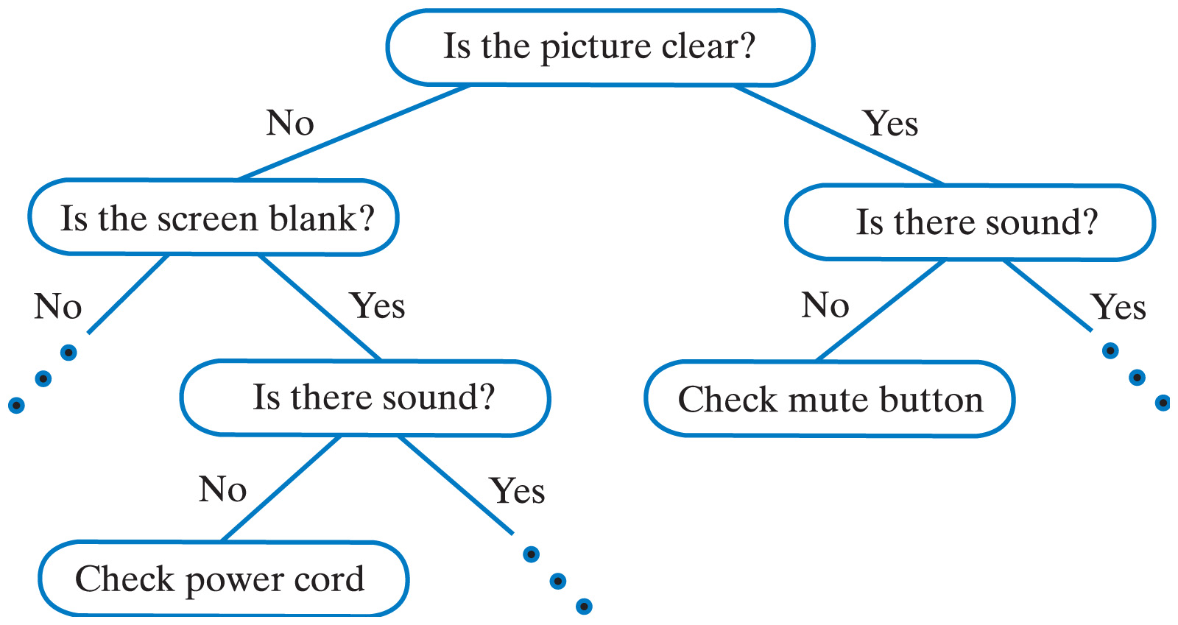
Binary Tree Applications
Decision trees
Look up, complexity
Traversal

Slide 15
Binary Tree
What is the number of nodes in a full binary tree with 4 levels?
Maximum Number of nodes of a binary tree with n levels?
Level 1
Level 2
2^{n} -1
Level 3
Level 4

Slide 16
Computing Depth/Height of a Tree
Depth of p: number of ancestors of p. If p is root, its depth is zero.
Example: depth of node 4 is 2.
if p is root, 0
else, 1+depth(p.getParent())
depth(p) =
Code Fragment 8.3 in the textbook
Algorithm depth( p) runs in O ( n ) worst- case time, where n is the total number of positions of T, because a position of T may have depth n- 1 if all nodes form a single branch.

Slide 17
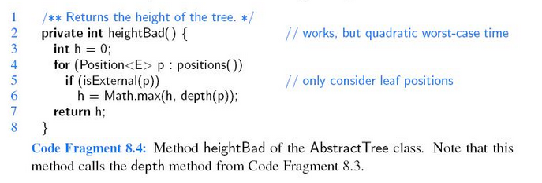
Computing Height of a Tree
What is the complexity?

Slide 18
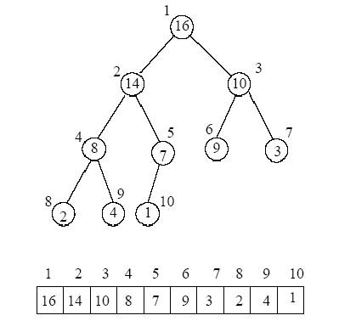
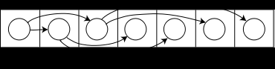
Array implementation of Binary Tree
Index numbers
What is the index of children of node in index i ?
Left child = 2i +1
Right child = 2i +2

Slide 19
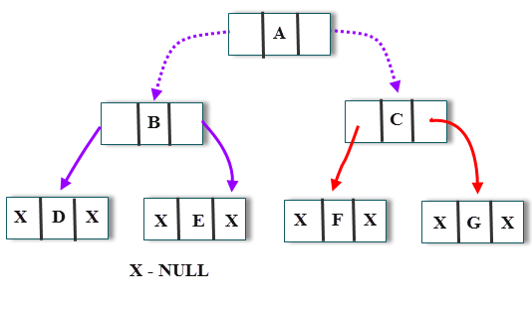
LinkedList Implementation of Binary Tree
What type of linked list is needed to implement binary trees? (Example – BB)

Slide 20
Traversal
A traversal is a process that visits all the nodes in the tree.
Depth-first Traversal
In-Order (Symmetric) left-root-right
Pre-Order root-left-right
Post-Order left-right-root
In-order:
2,8,4,14,1,7,16,9,10,3
Pre-order:
16,14,8,2,4,7,1,10,9,3
Post-order
2,4,8,1,7,14,9,3,10,16

Slide 21
Traversal Algorithms
In-order Algorithm
Step1: Recursively traverse left subtree
Step2: Visit root node
Step3: Recursively traverse right subtree
Pre-Order Algorithm
Step1: Visit root node
Step2: Recursively traverse left subtree
Step3: Recursively traverse right subtree
Post-Order Algorithm
Step1: Recursively traverse left subtree
Step2: Recursively traverse right subtree
Step3: Visit root node

Slide 22
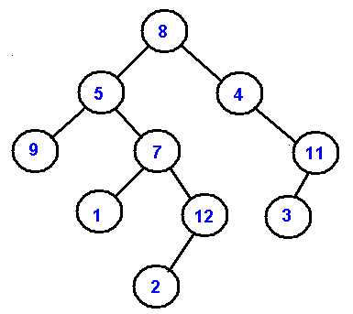
Practice
Depth-First:
PreOrder (Rlr)
8, 5, 9, 7, 1, 12, 2, 4, 11, 3
InOrder (lRr)
9, 5, 1, 7, 2, 12, 8, 4, 3, 11
PostOrder (lrR)
9, 1, 2, 12, 7, 5, 3, 11, 4, 8
Breadth-First:
LevelOrder
8, 5, 4, 9, 7, 11, 1, 12, 3, 2

Slide 23
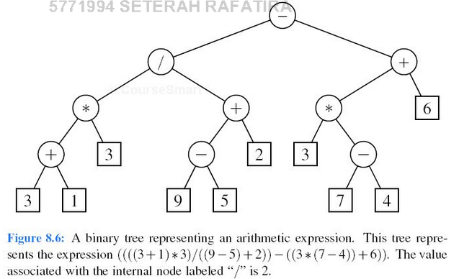
Exercise
Present an arithmetic expression using a binary tree:

Slide 24
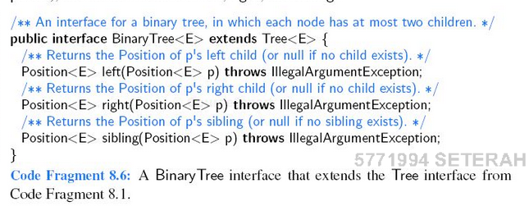
Binary Tree Interface
Followed by Ch8, p326

Slide 25
BST (Binary Search Tree): Insert
Use a data structure that stores elements after inserting the following keys (from left to right). The data structure is initially empty. Always start from the root. The left child key value is always <= parent, and the right child key value is > parent.
Key= {17, 9 , 26 , 12, 11 ,7,30,20,21,10}
Every element in n’s left subtree is less than or equal to the element in node n.
Every element in n’s right subtree is greater than the element in node n.

Slide 26
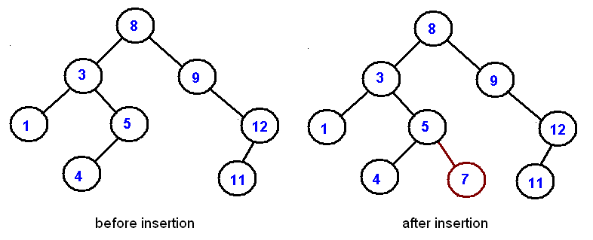
Insertion
Insert 7

Slide 27
Insertion
Draw a binary search tree by inserting the below numbers from left to right:
11, 6, 8, 19, 4, 10, 5, 17, 43, 49, 31
11
6
19
4
8
17
43
5
10
31
49

Slide 28
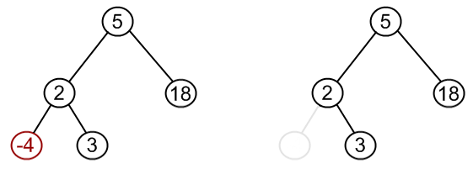
Delete
Node to be removed has no children:
Remove -4 from a BST.

Slide 29
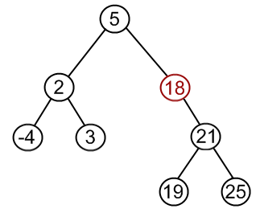
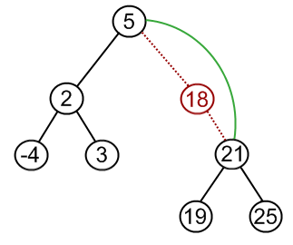
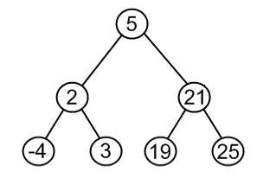
Delete
Node to be removed has one child.
Remove 18 from a BST.

Slide 30
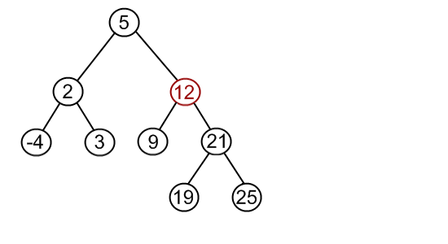
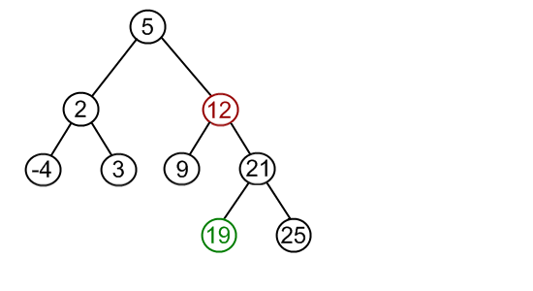
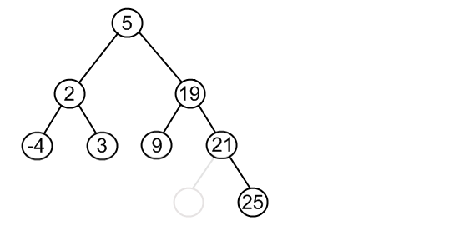
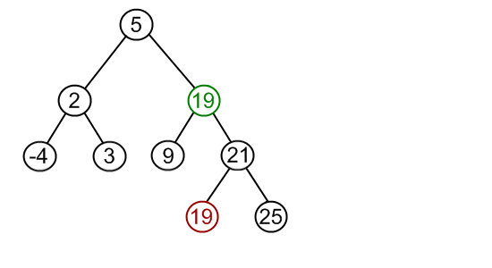
Delete
Node to be removed has two children (the most complex one).
Algorithm:
Find the minimum node in the right sub tree of the node that must be removed (i.e., 12).
Replace the node to be removed (i.e., 12) with the minimum node (i.e., 19).
Remove the node duplicate from its prior location (i.e., the original 19).

Slide 31
Priority Queue

Slide 32
Recap: Queue Operations
Insert at rear:
enqueue(6)
rear
6
rear
6
5
4
3
2
front
5
Remove from front:
dequeue()
4
3
2
1
1
This is the first element of the queue
front

Slide 33
Recap: Stack vs queue

Slide 34
Recap: Queue Functions
add(E e) - exception : return head and remove
offer(E e) -boolean :return head and remove
element() , peek() : return the head
remove()
isEmpty()

Slide 35
Priority Queue
A priority queue stores a collection of entries.
Each entry is a pair (key, value).
Main methods of the Priority Queue ADT:
insert(k, x) inserts an entry with key k and value x.
removeMin( ) removes and returns the entry with smallest key.
Additional methods:
min( ) returns, but does not remove, an entry with smallest key.
size( ), isEmpty( )
Applications:
Standby flyers.
Auctions.
Stock market.
© 2010 Goodrich, Tamassia

Slide 36
Priority queue (PQ)
import java.util.PriorityQueue;
Abstract Data Type
Collection of prioritized elements that allow arbitrary insertion, and allows the removal of elements that has first priority.
Add an element to PQ: the user designates its priority by providing an associated key.
Remove an element from PQ: the element with the minimal key will be the next to be removed from the PQ.
Key: a) numeric , b) comparable objects. Application dependent.

Slide 37
Entry
An entry in a priority queue is simply a key-value pair.
Priority queues store entries to allow for efficient insertion and removal based on keys.
Methods:
getKey: returns the key for this entry.
getValue: returns the value associated with this entry.
As a Java interface:
/**
* Interface for a key
*value pair entry
**/
public interface Entry<K,V>
{
public K getKey();
public V getValue();
}
© 2010 Goodrich, Tamassia

Slide 38
Comparator
A comparator encapsulates the action of comparing two objects according to a given total order relation.
A generic priority queue uses an auxiliary comparator.
The comparator is external to the keys being compared.
When the priority queue needs to compare two keys, it uses its comparator.
Primary method of the Comparator ADT
compare(x, y): returns an integer i such that
i < 0 if a < b,
i = 0 if a = b
i > 0 if a > b
An error occurs if a and b cannot be compared.
© 2010 Goodrich, Tamassia

Slide 39
Priority Queue Sorting
We can use a priority queue to sort a set of comparable elements
Insert the elements one by one with a series of insert operations.
Remove the elements in sorted order with a series of removeMin operations.
The running time of this sorting method depends on the priority queue implementation
Algorithm PQ-Sort(S, C)
Input sequence S, comparator C for the elements of S
Output sequence S sorted in increasing order according to C
P ← priority queue with comparator C
while !S.isEmpty ()
e ← S.removeFirst ()
P.insert (e, ∅)
while !P.isEmpty()
e ← P.removeMin().getKey()
S.addLast(e)
© 2010 Goodrich, Tamassia

Slide 40
Run this Example
import java.util.Comparator;
import java.util.PriorityQueue;
import java.util.Queue;
import javax.swing.JOptionPane;
public class TestPQ {
//add 30,10,20,1,8,0,5, then print the sorted list
public static void main(String[] args) {
Comparator<Integer> cmp = new IntComp();
Queue<Integer> pq= new PriorityQueue<Integer>(10, cmp);
String menu = "1- Add \n2-Print \n3-Exit.”;
int option =0;
do{ option = Integer.parseInt(JOptionPane.showInputDialog(menu));
switch(option){ case 1: //Add:
Integer in = Integer.parseInt(JOptionPane.showInputDialog("Enter an integer” +
“value"));
pq.add(in);
break;
case 2: //Print:
String out= "";
while(!pq.isEmpty()) out+=pq.remove() + ",";
JOptionPane.showMessageDialog(null, out); break;
case 3: System.exit(0);
}}while (option!=3);
}}

Slide 41
PQ Operations
insert(k,v): creates an entry with key k and value v in the PQ.
min(): returns (but does not remove) a PQ entry (k,v) having minimal key; returns null if the PQ is empty.
removeMin(): removes and returns an entry (k,v) having minimal key from the PQ; returns null if the PQ is empty.
size(): returns the number of entries in the PQ.
isEmpty(): returns a boolean indicating whether the PQ is empty.

Slide 42
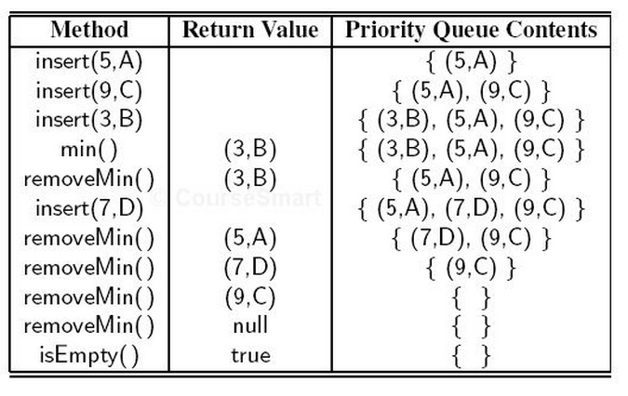
Example 9.1
Assume a PQ is initially empty. Describe the changes given the following table.

Slide 43
Sequence-based Priority Queue
Implementation with an unsorted list
Performance:
insert takes O(1) time since we can insert the item at the beginning or end of the sequence.
removeMin and min take O(n) time since we have to traverse the entire sequence to find the smallest key.
Implementation with a sorted list
Performance:
insert takes O(n) time since we have to find the place where to insert the item
removeMin and min take O(1) time, since the smallest key is at the beginning
4
5
2
3
1
1
2
3
4
5
© 2010 Goodrich, Tamassia

Slide 44
Operation Complexity (Sorted List)
PQ is implemented with a doubly linked List:
insert(k,v)
creates an entry with key k and value v in the P
O(n)
min()
returns (but does not remove) a PQ entry (k,v) having minimal key; returns null if the PQ is empty.
O(1)
removeMin()
removes and returns an entry (k,v) having minimal key from the PQ; returns null if the PQ is empty.
O(1)
size()
returns the number of entries in the PQ.
O(1)
isEmpty()
returns a boolean indicating whether the PQ is empty.
O(1)

Slide 45
Operation Complexity (Unsorted List)
PQ is implemented with a doubly linked List:
insert(k,v)
creates an entry with key k and value v in the P
O(1)
min()
returns (but does not remove) a PQ entry (k,v) having minimal key; returns null if the PQ is empty.
O(n)
removeMin()
removes and returns an entry (k,v) having minimal key from the PQ; returns null if the PQ is empty.
O(n)
size()
returns the number of entries in the PQ.
O(1)
isEmpty()
returns a boolean indicating whether the PQ is empty.
O(1)

Slide 46
Sorted vs. Unsorted PQ (insert, min, removemin, size , isempty)
9,A
8,B
6,Q
2,N
1,H
Sorted PQ , n = 5
1,H
8,B
9,A
6,Q
2,N
UnSorted PQ, n=5

Slide 47
Selection-Sort
Selection-sort is the variation of PQ-sort where the priority queue is implemented with an unsorted sequence.
Running time of Selection-sort:
Inserting the elements into the priority queue with n insert operations takes O(n) time.
Removing the elements in sorted order from the priority queue with n removeMin operations takes time proportional to 1 + 2 + …+ n
Selection-sort runs in O(n²) time
© 2010 Goodrich, Tamassia

Slide 48
Selection-Sort Example
Sequence S Priority Queue P
Input: (7,4,8,2,5,3,9) ( )
Phase 1
(a) (4,8,2,5,3,9) (7)
(b) (8,2,5,3,9) (7,4)
.. .. ..
(g) ( ) (7,4,8,2,5,3,9)
Phase 2
(a) (2) (7,4,8,5,3,9)
(b) (2,3) (7,4,8,5,9)
(c) (2,3,4) (7,8,5,9)
(d) (2,3,4,5) (7,8,9)
(e) (2,3,4,5,7) (8,9)
(f) (2,3,4,5,7,8) (9)
(g) (2,3,4,5,7,8,9) ( )
© 2010 Goodrich, Tamassia

Slide 49
Insertion-Sort
Insertion-sort is the variation of PQ-sort where the priority queue is implemented with a sorted sequence.
Running time of Insertion-sort:
Inserting the elements into the priority queue with n insert operations takes time proportional to
1 + 2 + …+ n
Removing the elements in sorted order from the priority queue with a series of n removeMin operations takes O(n) time.
Insertion-sort runs in O(n²) time
© 2010 Goodrich, Tamassia

Slide 50
Insertion-Sort Example
Sequence S Priority queue P
Input: (7,4,8,2,5,3,9) ( )
Phase 1
(a) (4,8,2,5,3,9) (7)
(b) (8,2,5,3,9) (4,7)
(c) (2,5,3,9) (4,7,8)
(d) (5,3,9) (2,4,7,8)
(e) (3,9) (2,4,5,7,8)
(f) (9) (2,3,4,5,7,8)
(g) ( ) (2,3,4,5,7,8,9)
Phase 2
(a) (2) (3,4,5,7,8,9)
(b) (2,3) (4,5,7,8,9)
.. .. ..
(g) (2,3,4,5,7,8,9) ( )
© 2010 Goodrich, Tamassia

Slide 51
Entry , PriorityQueue Interfaces
public interface Entry<K,V> {
public K getKey();
public V getValue();
}
public interface PriorityQueue<K,V> {
public int size();
public boolean isEmpty();
public Entry<K,V> insert(K key , V value) throws IllegalArgumentException;
Entry<K,V> min();
Entry<K,V> removeMin();
}

Slide 52
Default Comparator
import java.util.Comparator;
/* A DefaultComparator class that implements a comparator based -
upon the natural ordering of its element type. */
public class DefaultComparator<E> implements Comparator<E> {
public int compare(E a , E b) throws ClassCastException{
return ((Comparable<E>) a).compareTo(b);
}
}

Slide 53
Abstract Priority Queue
import java.util.Comparator;
import javax.swing.DefaultComboBoxModel;
/** An abstract class to assist implementations of the PriorityQueue interface.*/
public abstract class AbstractPriorityQueue<K,V> implements PriorityQueue<K,V> {
//-------------nested PQEntry class----------------
public class PQEntry<K,V> implements Entry<K,V>{
private K k;
private V v;
public PQEntry(K key , V value){
k = key;
v = value;
}
public K getKey() {return k;}
public V getValue() {return v; }
protected void setKey(K key) {k = key;}
protected void setValue(V value) {v=value;}
} //---------------end of nested PQEntry class ----------------
private Comparator<K> comp;
protected AbstractPriorityQueue(Comparator<K> c){comp = c;}
protected AbstractPriorityQueue() {this(new DefaultComparator<K>()); }
protected int compare (Entry<K,V> a,
Entry<K,V> b){
return comp.compare(a.getKey(),
b.getKey()); }
protected boolean checkKey(K key) throws IllegalArgumentException{
try{
return (comp.compare(key, key)==0);
}catch(ClassCastException e){
throw new
IllegalArgumentException("Incompatible key");}
}
public boolean isEmpty(){ return size()==0; }
}

Slide 54
Sorted Priority Queue
import java.util.Comparator;
import Lecture8.LinkedPositionalList.*
public class SortedPriorityQueue<K,V> extends AbstractPriorityQueue<K, V> {
private PositionalList<Entry<K,V>> list = new LinkedPositionalList<Entry<K,V>>();
public SortedPriorityQueue( ) { super( ); }
public SortedPriorityQueue(Comparator<K> comp) { super(comp); }
public int size() {
return list.size();
}
public Entry<K, V> insert(K key, V value) throws IllegalArgumentException {
checkKey(key);
Entry<K,V> newest = new PQEntry<K, V>(key,value);
Position<Entry<K,V>> walk = list.last();
while(walk != null && compare(newest , walk.getElement()) < 0)
walk = list.before(walk);
if(walk==null)
list.addFirst(newest);
return newest;
}

Slide 55
Sorted Priority Queue
public Entry<K, V> min() {
if(list.isEmpty()) return null;
return list.first().getElement();
}
public Entry<K, V> removeMin() {
if(list.isEmpty()) return null;
return list.remove(list.first());
}
} //end of SortedPrirotyQueue class

Slide 56
Lab 3: Group Activity
In an air-traffic control center, an agent assigns priority to ready-to-land airplanes. Higher priority is given to the connective flights with short-period connections. Every flight has a flightNumber, pilot name, number of passengers, and whether or not that flight is connective. Design a data definition class “Flight.java” to model the above description. Then design an implementation class that assigns appropriate priorities to the flights, and provides landing service to flights according to their assigned priority. Use PriorotyQueue code supplement on BB.

